Slide 1
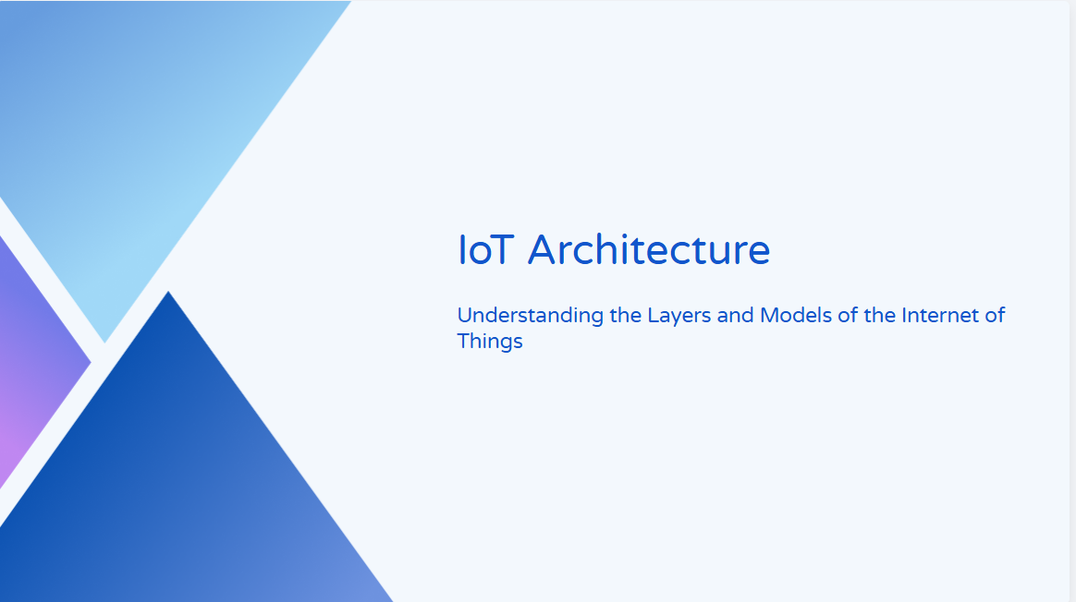
MDM IoT : Unit 3

Slide 2
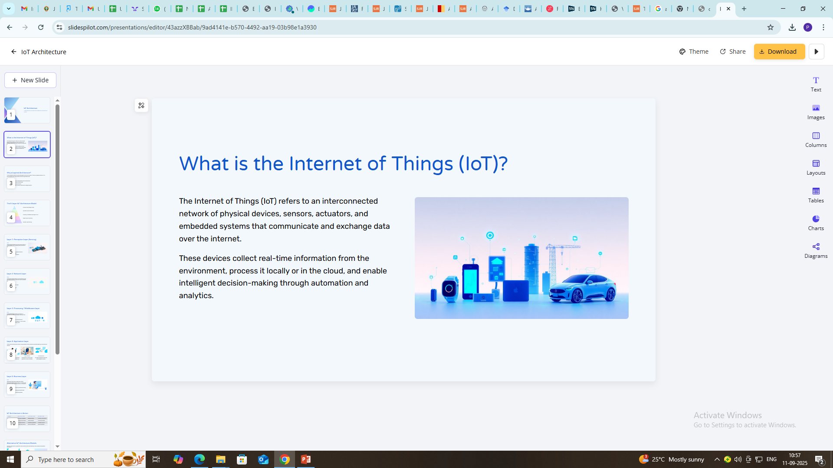

Slide 3
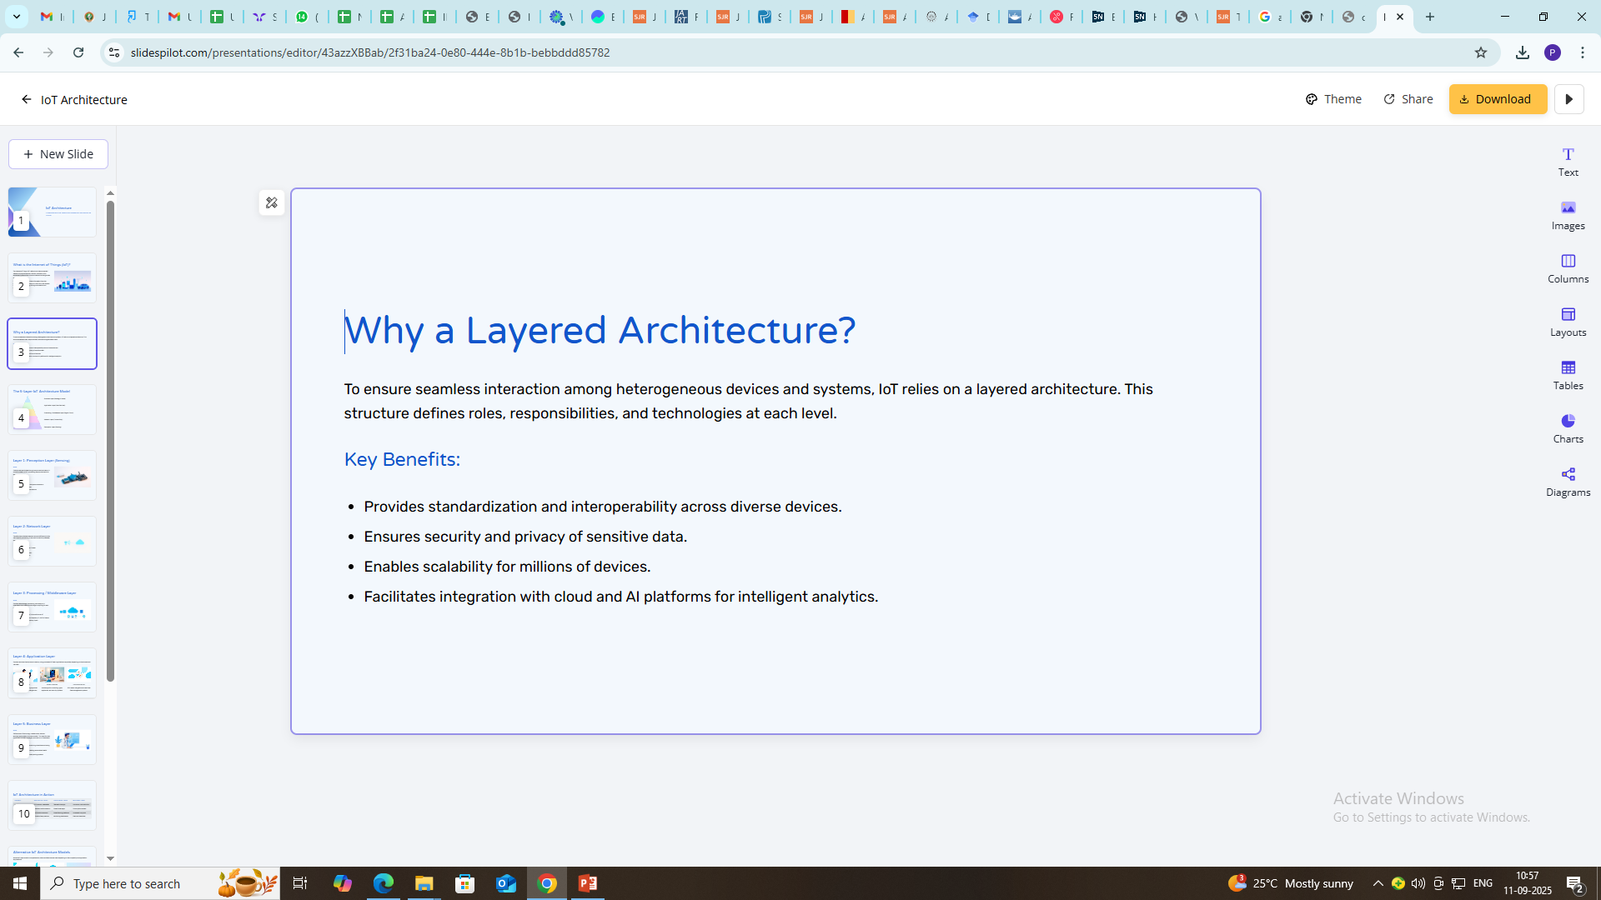

Slide 4
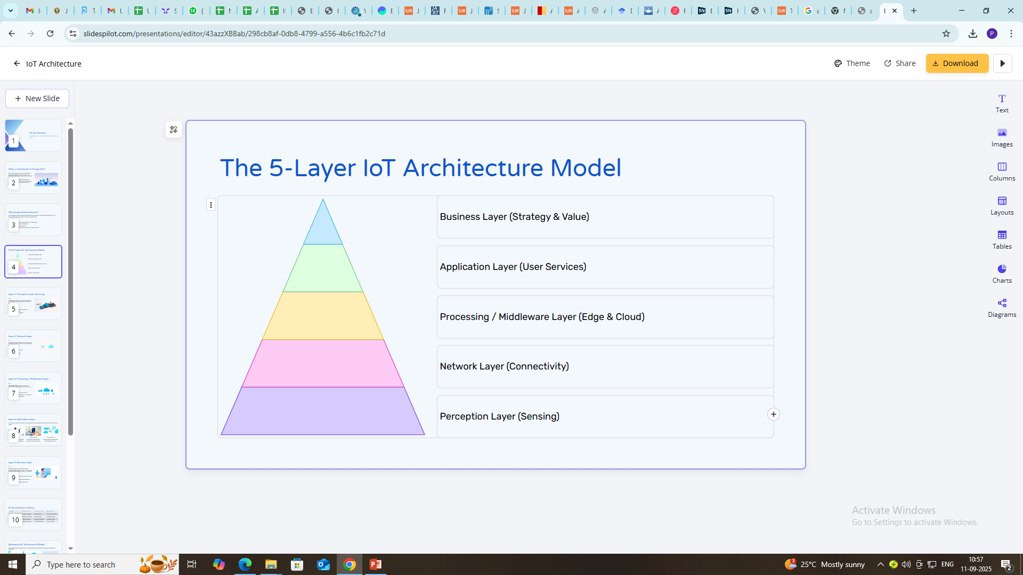

Slide 5
| Business Layer |
| - Business models, profit strategies, decision-making |
| - Example: Predictive maintenance in industries |
+--------------------------------------------------------------------------+
| Application Layer |
| - End-user services and applications |
| - Examples: Smart homes, e-healthcare, smart cities |
+--------------------------------------------------------------------------+
| Processing / Middleware Layer |
| - Data aggregation, filtering, analytics, edge/cloud |
| - Examples: Cloud servers, IoT platforms (AWS IoT) |
+--------------------------------------------------------------------------+
| Network Layer |
| - Data transmission and communication protocols |
| - Examples: Wi-Fi, 5G, ZigBee, LoRaWAN |
+--------------------------------------------------------------------------+
| Perception Layer |
| - Sensors, RFID, actuators, cameras, GPS |
| - Examples: Heart-rate sensors, smart meters |
+--------------------------------------------------------------------------+

Slide 6
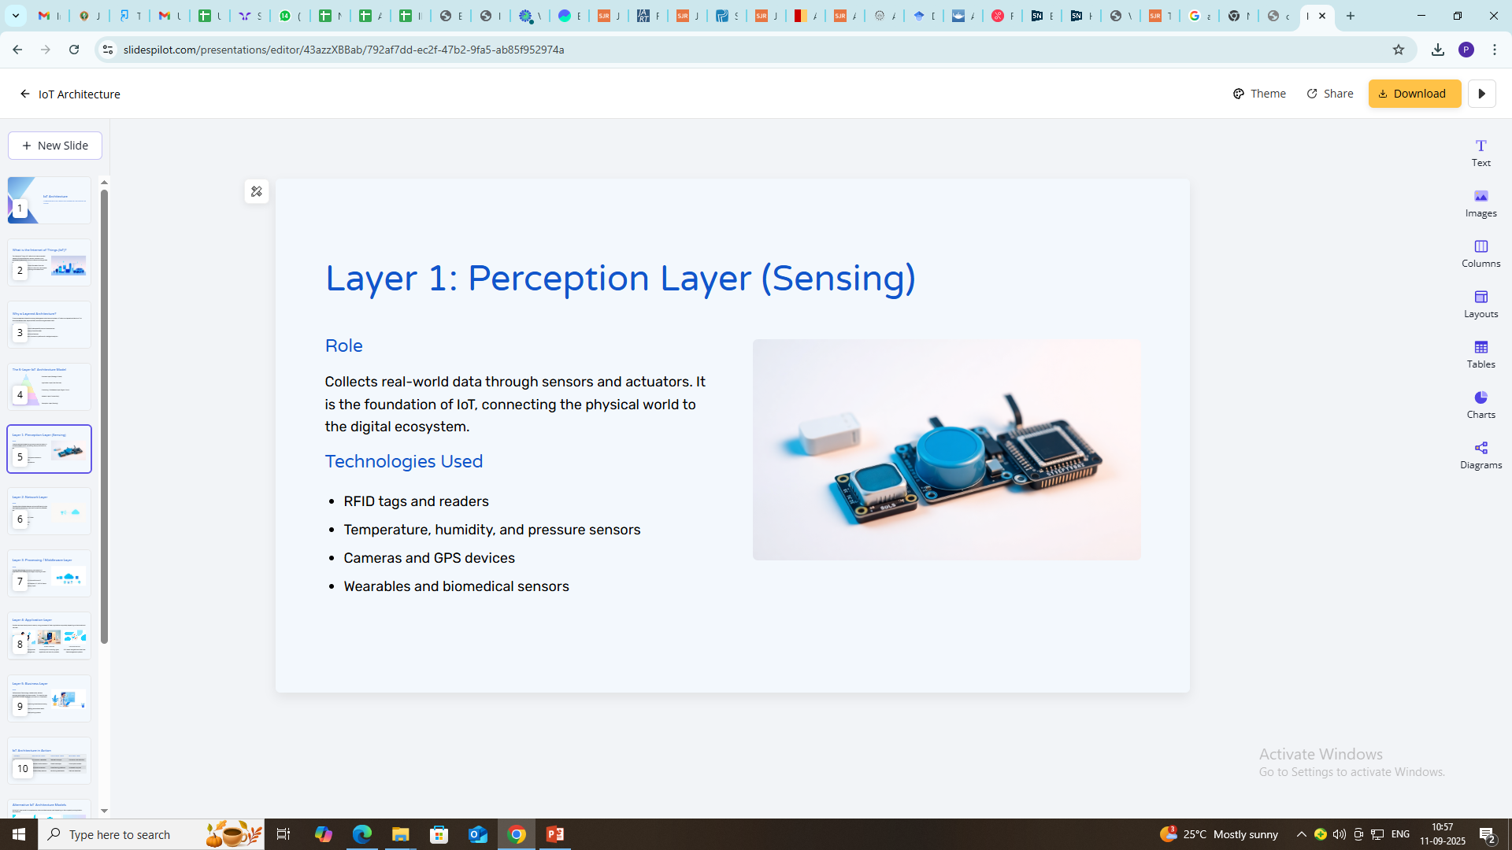

Slide 7
Perception Layer (Sensing Layer)
Real-World Examples:
Healthcare: Wearable ECG monitors measuring heart rate.
Smart Homes: Motion detectors for security.
Agriculture: Soil moisture sensors to optimize irrigation.

Slide 8
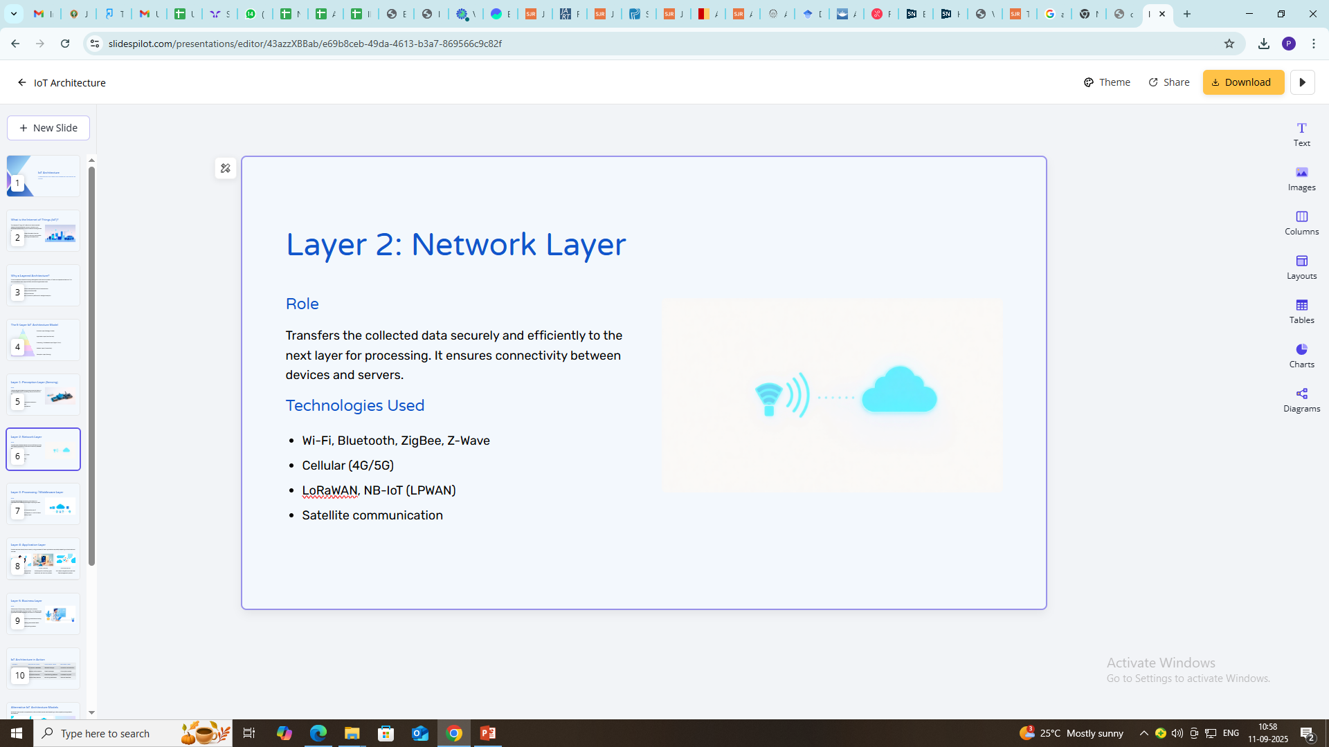

Slide 9
Network Layer
Real-World Examples:
Healthcare: Wearable devices transmitting ECG data via Bluetooth to smartphones.
Smart Cities: Traffic sensors using 5G to send real-time traffic flow updates.
Industry 4.0: Wireless sensor networks monitoring machine health.

Slide 10
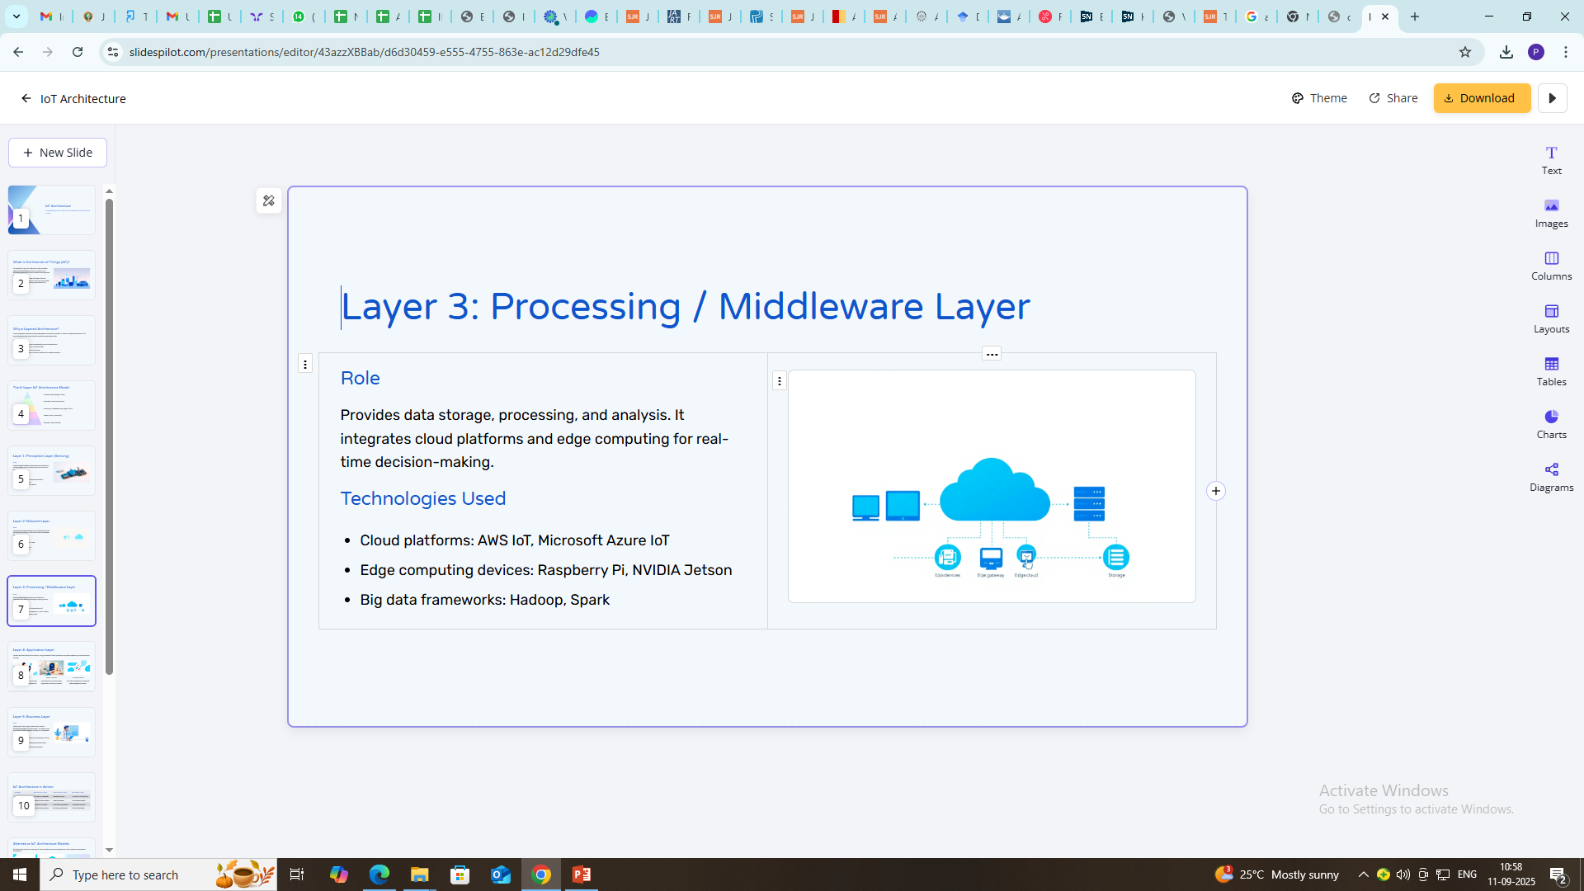

Slide 11
Processing / Middleware Layer
Real-World Examples:
Healthcare: Cloud-based patient health record analysis.
Smart Homes: Edge processors in smart speakers (e.g., Amazon Alexa) analysing voice commands.
Agriculture: Edge computing nodes predicting crop diseases based on sensor inputs.

Slide 12
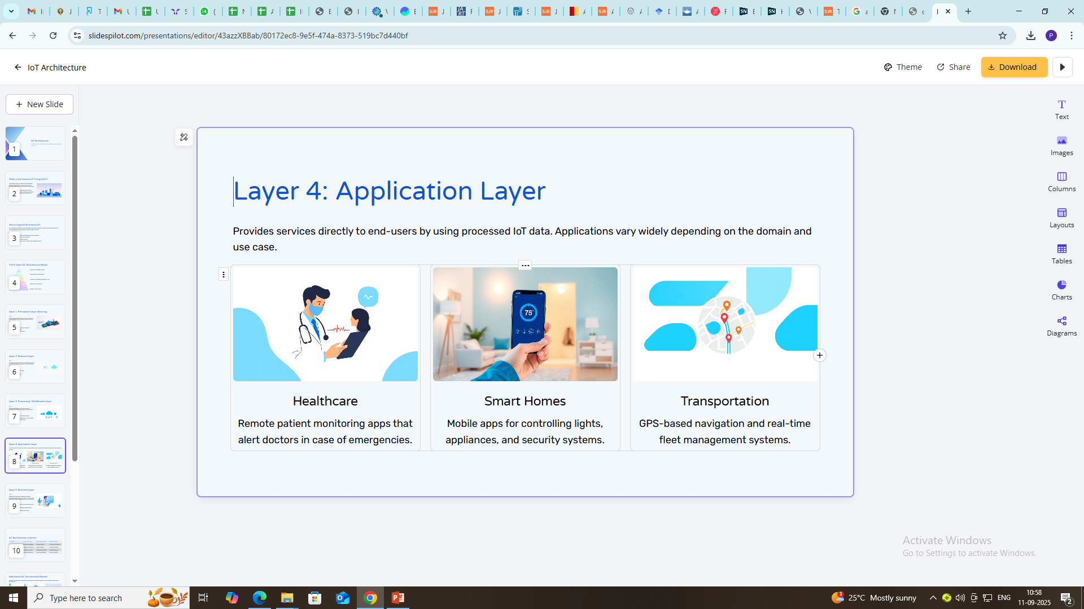

Slide 13
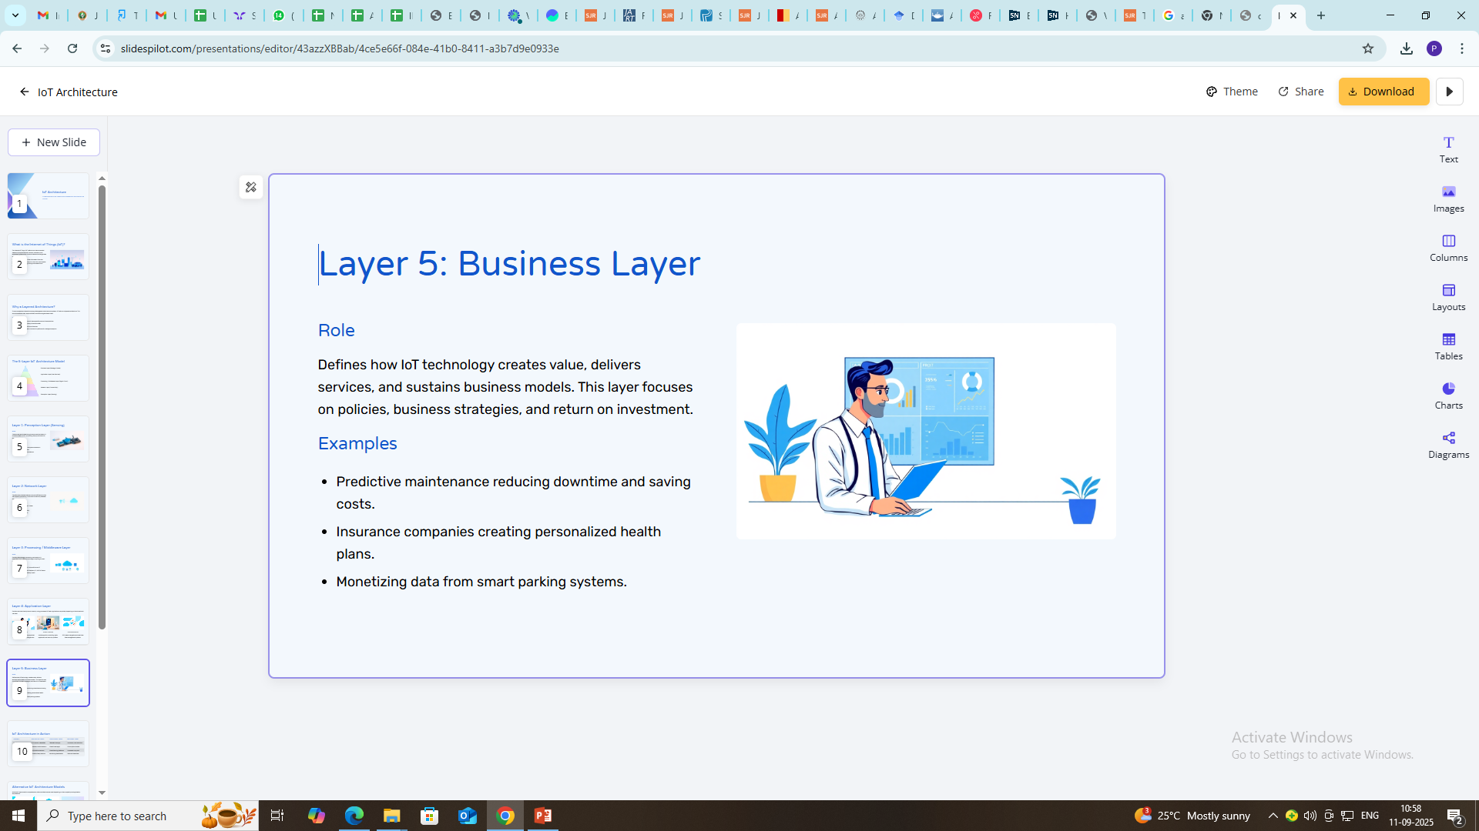

Slide 14
Summary of Real-World Applications Across Layers
Domain | Perception Layer | Network Layer | Processing Layer | Application Layer | Business Layer
Healthcare | ECG sensors, wearables | Bluetooth, 5G | Cloud/AI patient monitoring | Telemedicine apps | Insurance, cost reduction
Smart Homes | Cameras, motion sensors | Wi-Fi, ZigBee | Edge processors (Alexa) | Smart home apps | Subscription models
Agriculture | Soil/moisture sensors | LoRaWAN, NB-IoT | Predictive analytics | Smart farming platforms | Increased crop yield
Smart Cities | Traffic/air sensors | 5G, LPWAN | Big data analytics | Smart city dashboards | Revenue from smart infra
Industry 4.0 | Vibration/temp sensors | Industrial IoT (IIoT) | Predictive maintenance | Monitoring dashboards | Reduced downtime

Slide 15
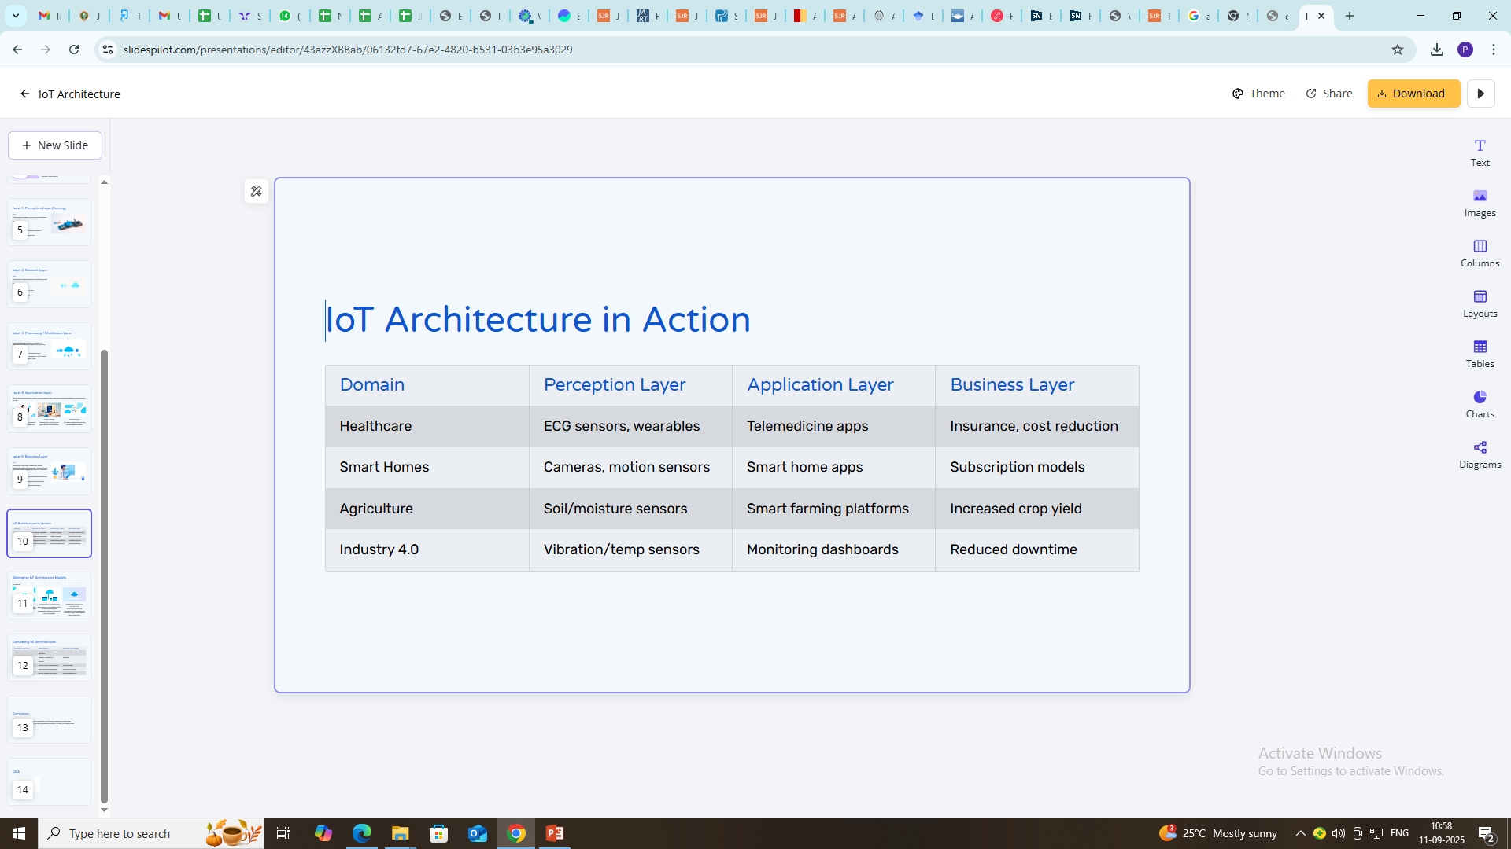

Slide 16
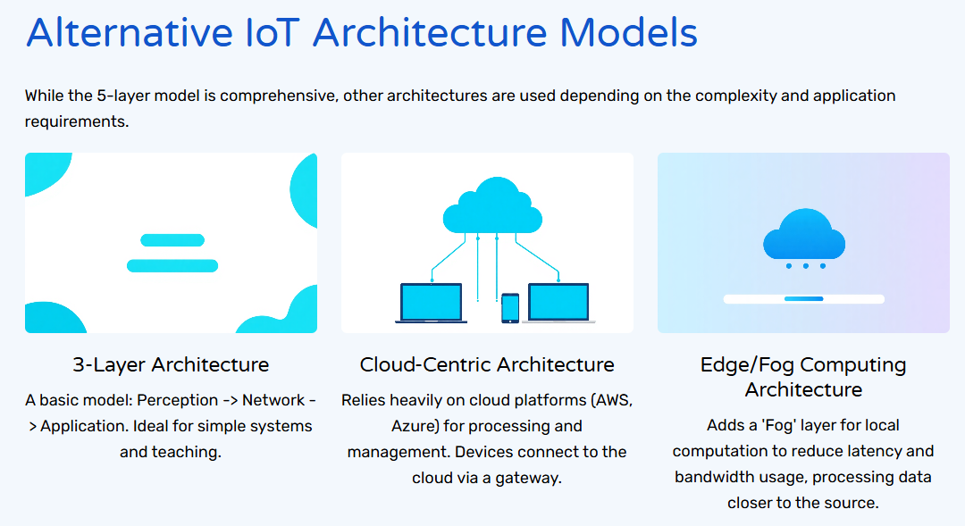


Slide 17
Types of Architecture
IoT (Internet of Things) architecture describes how IoT devices, networks, data, and applications are organized and interact with each other. Different models exist, but most follow layered structures. Here are the main types of IoT architectures:
Cloud-Based Architecture
Fog Computing Architecture
Service-Oriented Architecture (SOA)
Block chain-Based Architecture)
Other types : 3-layer and 5-layer

Slide 18
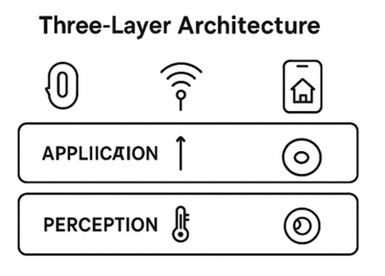
Three-Layer Architecture (Traditional Model)
This is the most basic IoT architecture, widely used for teaching and simple deployments.
Layers:
Perception Layer (Sensing Layer)
Includes sensors, actuators, RFID, cameras, GPS, etc.
Responsible for collecting physical data (e.g., temperature, pressure, heart rate).
Example: A smart home thermostat sensing room temperature.
Network Layer
Transmits data from devices to other devices or servers via communication protocols.
Technologies: Wi-Fi, Bluetooth, Zigbee, LoRaWAN, 5G, MQTT, etc.
Example: Data from a wearable health band sent to a cloud server via Bluetooth and the Internet.
Application Layer
Provides services to end-users (visualization, analytics, decision-making).
Example: Healthcare dashboard showing patient vitals, or a smart home app controlling lights.

Slide 19
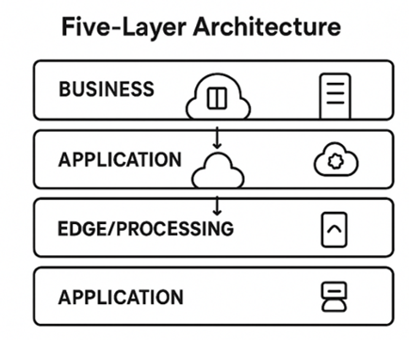
Five-Layer Architecture (Enhanced Model)
This adds more granularity for large-scale IoT systems.
Layers:
Perception Layer – Data collection using sensors/actuators.
Network Layer – Communication (Wi-Fi, 5G, Zigbee, etc.).
Edge/Processing Layer (Middleware Layer) – Pre-processing, filtering, and real-time analytics near the source.
Example: Edge gateways in smart factories filtering machine data before sending to the cloud.
Application Layer – User-oriented services.
Business Layer – Defines rules, policies, revenue models, and manages entire IoT system.
Example: A hospital’s IoT system decides billing, compliance, and reporting policies.

Slide 20
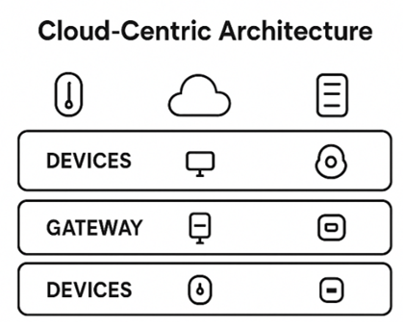
Cloud-Centric IoT Architecture
Relies heavily on cloud platforms (AWS IoT, Microsoft Azure IoT, Google Cloud IoT).
Devices → Gateway → Cloud → Application.
Advantages: Scalability, centralized control, AI/ML integration.
Example: Smart city traffic management system using Google Cloud for analytics.

Slide 21
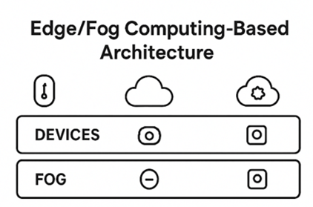
Edge/Fog Computing-Based Architecture
Introduced to solve latency, bandwidth, and privacy issues of cloud-only models.
Fog Layer (between devices and cloud): Performs computation, filtering, and storage near the edge.
Example: Autonomous vehicles use edge nodes to process sensor data in real time without relying solely on the cloud.

Slide 22
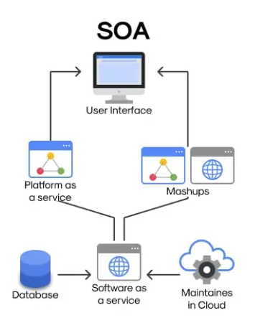
Service-Oriented IoT Architecture (SOA-Based)
Focuses on services rather than layers.
Devices, communication, and apps are treated as service components that can be reused and orchestrated.
Example: A smart healthcare system where monitoring, alerting, and data sharing are modular services.

Slide 23
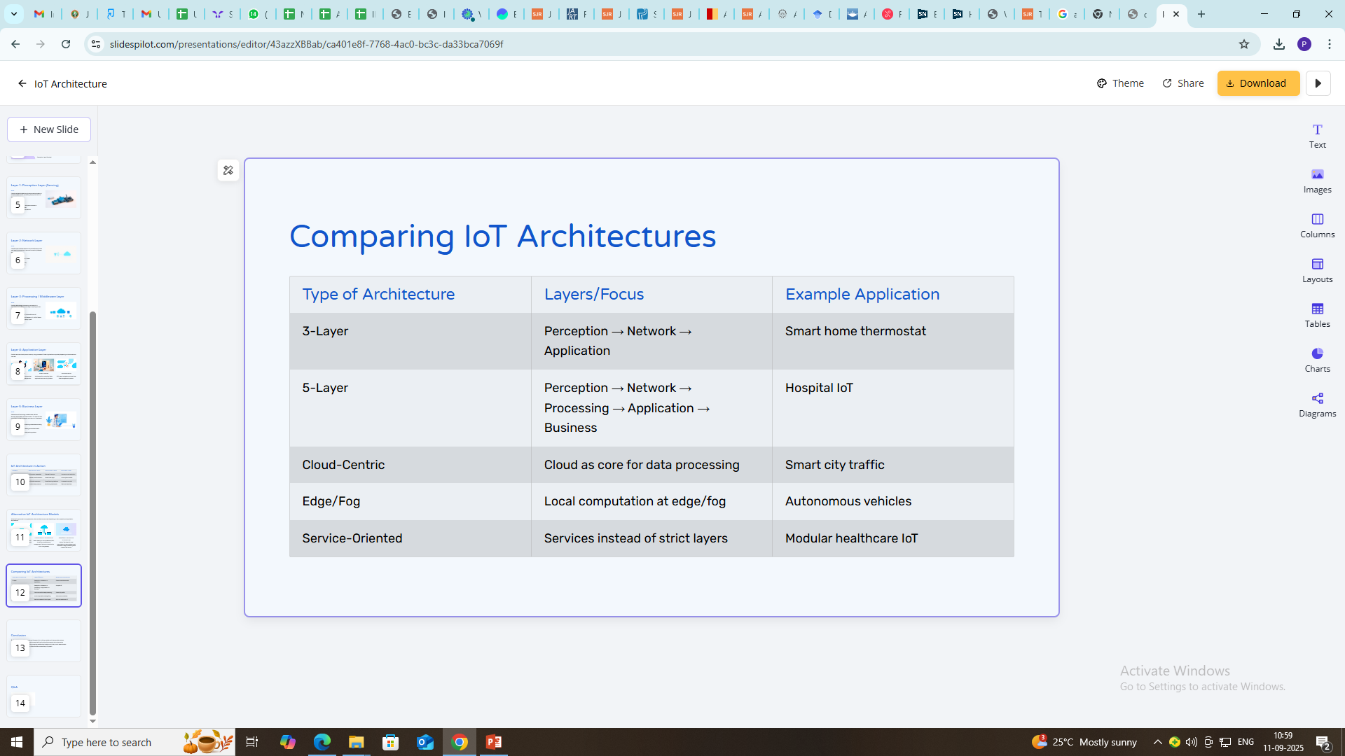

Slide 24
A block-chain-based architecture
It is a system of decentralized computer nodes, each holding a copy of a shared, cryptographically linked ledger of transactions.
Key components include a network of nodes, cryptographic hashing to link data into immutable blocks, and consensus mechanisms for network-wide agreement on transactions.
The layered structure typically involves application, protocol, network, data, and hardware layers, forming a secure, transparent, and tamper-proof foundation for decentralized applications.

Slide 25
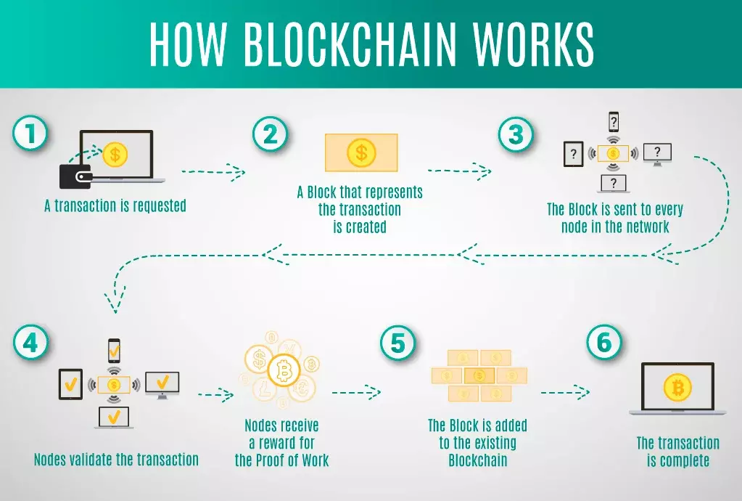

Slide 26
Block chain based Architecture continue…
How it Works
Transaction Request: A user initiates a transaction.
Block Creation: This transaction is bundled with others into a new block.
Validation: The new block is broadcast to all nodes in the network for validation using a consensus mechanism (e.g., Proof of Work, Proof of Stake).
Block Addition: Once validated by the network, the block is added to the existing chain, linked by cryptographic hash.
Immutability: The inclusion of the previous block's hash creates a secure, permanent, and transparent record.

Slide 27
